Slide 1
CS4001- Professional Practices in IT
FALL 2025
Course Instructor: Anaum Hamid
Email address: anaum.hamid@nu.edu.pk

Slide 2
Lecture # 2
Legal/Illegal
Moral/Immoral

Slide 3
Rights
Rights are entitlements or freedoms that people possess, often protected by laws or social norms.
They can be legal, social, or ethical principles that define what people are allowed to do or have, or what others owe them.
Examples:
“You have no right to tell me what to do”
“ I have the right to do that”

Slide 4
Categorizing Rights
Philosophers often make an important distinction in the nature and type of (how to consider) rights as:
Negative Rights
Positive Rights

Slide 5
Negative Rights
Negative rights are those rights which require restraint by others.
Examples:
My right of not to be killed, robbed, poisoned, harmed and so on. It requires others refrain from killing, robbing, poisoning me…….
However negative rights does not require that others take action to keep me alive, putting locks and guards to save me from being robbed …………..
Negative rights require the government to refrain from acting in certain ways; governments can respect individuals' negative rights simply by doing nothing at all.

Slide 6
Positive Rights
Positive rights are those which implies others have a duty towards the right holder.
Example:
If I have a right to live then not only others have to refrain from killing me but also they need to feed me, keep me safe etc.

Slide 7
Positive Rights
Positive rights require the government to act in certain ways.
The government must take a hands-on approach to ensure that guaranteed positive rights are accessible to the rights-holders.
Positive rights therefore place a heavy burden on the government by requiring that resources be allocated in specific ways, and with limited flexibility.

Slide 8
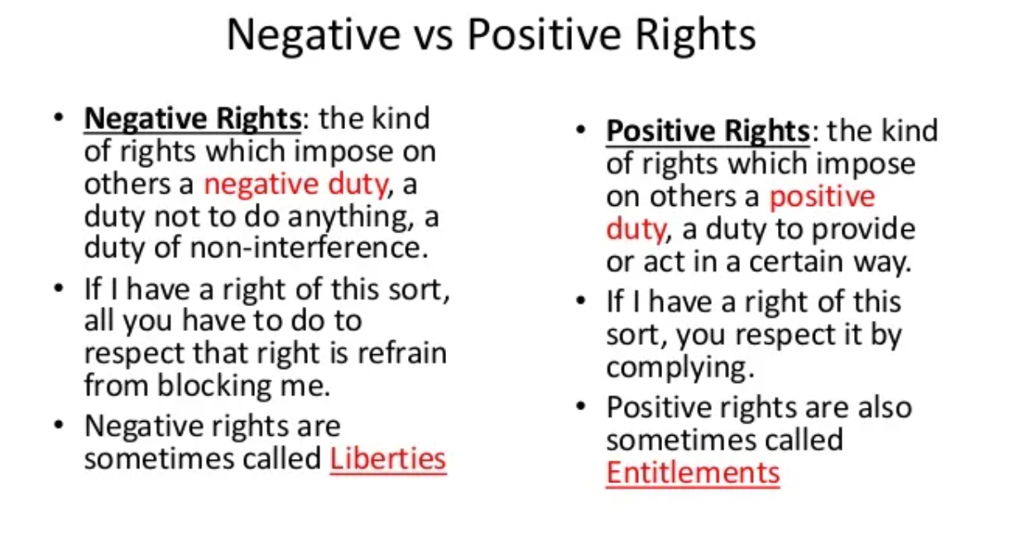

Slide 9
Further classes of Rights
Legal Rights
Moral Rights

Slide 10
Legal Rights
Legal rights are rights created and applied by the law.
The law enforces a statement or code of conduct, a deed to be done or rule to follow and fixes a punishment against violating the law.
Rights formally recognized and protected by law

Slide 11
Moral Rights
Moral , natural or human rights are independent from the law.
A civilized society’s first line of defense is not the law, police and courts but customs, traditions and moral values.
Behavioral norms, mostly transmitted by example, word of mouth and religious teachings, represent a body of wisdom distilled over the ages through experience and trial and error.

Slide 12
Moral vs Legal
Moral status leads to let you decide on the base of good or bad consciousness, religious training, manners etc. Although it does not involve penalty in violating such rights, but a feeling of guilt is always there to follow.
Legal status enforces your deeds on the grounds of defined law and has a penalty or punishment for those violating such rights or laws.

Slide 13
Case 1 (Polluting the environment)
Moral status
Don’t throw waste papers on the ground it will pollute the environment
Legal status
Making the case legal how????

Slide 14
Case 2 (Oldies get a seat in a loaded bus)
Moral Status
Youngers should give the oldies a seat ; good manners
Legal Status
Label some seats for the oldies and fine those youngsters who don’t give away the seats for the oldies

Slide 15
Case 3 (Password privacy in an organization)
Moral status
No one is supposed to share their password else their data can be tampered, stolen etc..
Legal status
If any one leaks his/her password he/she should pay a fine and suspended for a day.

Slide 16
Case 4 (An institute giving degrees to those who are not eligible vs giving degrees which are not recognized)
Moral status
No one is supposed to give degrees unless the requirements are fulfilled. Low standards of required skill are against moral values.
Legal status
If some one provides degrees which are not recognized by any higher commission or whose charter is not valid.

